Slide 1
Click on the tabs to learn more about 2nd grade!
teachers
What to expect
classroom
Remote learning
FAQ
website
WELCOME To second Grade
Welcome back to the 2020 - 2021 school year! We all hope you have enjoyed your summer and are ready to learn new things.
This year things may look a little different. First of all, your teacher and classmates will be wearing a mask during most of the school day. Also, in the classroom you will notice that your classmates are spread out. We are doing this to help stop the spread of germs. During the day we will have breaks for us to wash or sanitize our hands.
Don’t worry! Even with these changes, we will still have a lot of cool lessons and have fun learning.

Slide 2
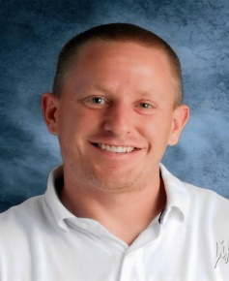
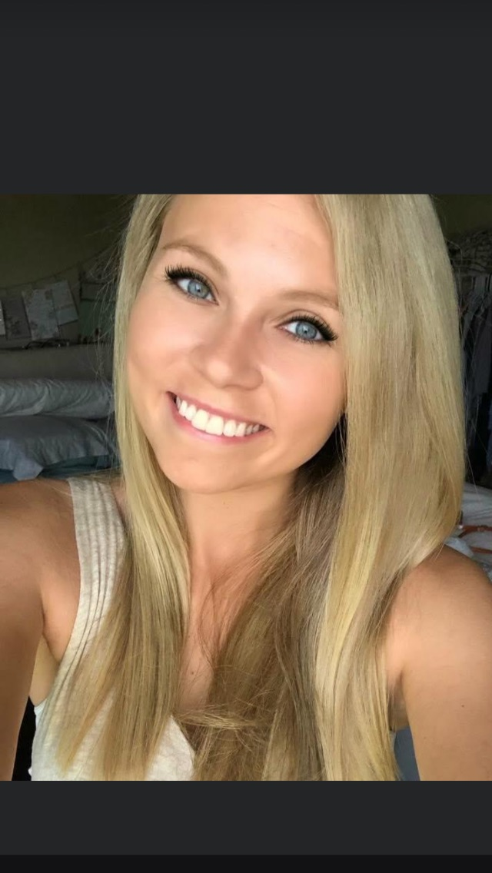
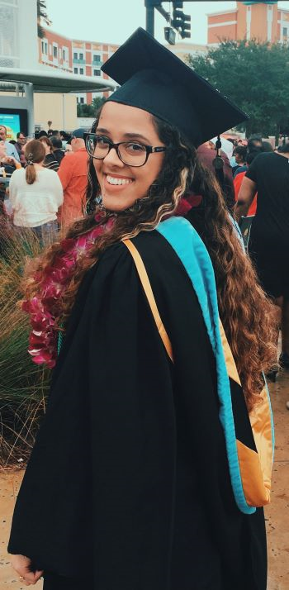
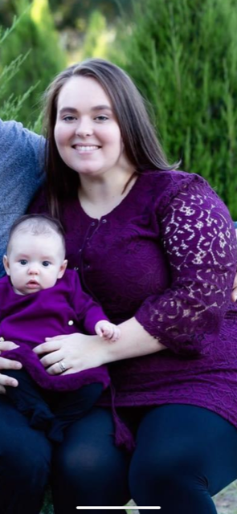
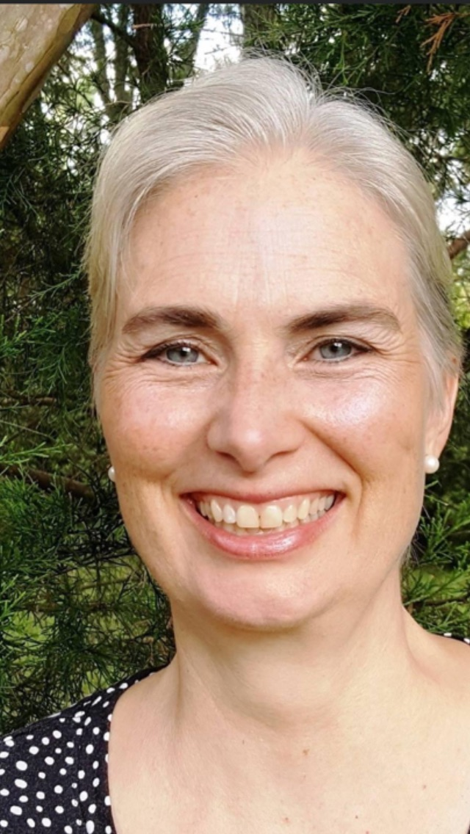
WELCOME To second grade
teachers
What to expect
classroom
Remote learning
faq
WEBSITE & EMAIL
My name is Mrs. Brubaker. This will be my 3rd year teaching at Choices In Learning.
My name is Mr. Miller. This will be my second year teaching at Choices In Learning.
My name is Miss Jimenez. This will be my first year teaching at Choices In Learning.
My name is Mrs. Gekas. This will be my first year teaching at Choices In Learning.
My name is Miss Smith.. This will be my first year teaching at Choices In Learning.

Slide 3
WELCOME To second grade
About Me
What to expect
classroom
Remote learning
FAQ
WEBSITE & EMAIL
We are so excited to have you in Second Grade this year! In Second Grade you will start receiving letter grades.
You will go to recess twice per week.
Homework will be assigned daily. Students will have math homework on ThinkCentral. Math work pages will be sent home for extra practice. There will be 30 minutes of Reading homework every night. Passagework and fluency will be uploaded to googleclassroom. Please make sure to sign your child’s planner to indicate they have completed their Reading homework each night.
2nd Grade Schedule
(M, T, TH, F)
SFA Reading | 8:50am - 10:25am
Math | 10:25am - 11:25am
SPAM | 11:25am - 12:15pm
Lunch | 12:15pm –12:45pm
World Lab | 12:50pm - 1:50pm
ELA | 1:50pm - 3:15pm

Slide 4
2nd Grade Grading Policy Grading Scale for All Subjects A 90%-100% B 80%-89% C 70%-79% D 60%-69% Zero Policy The lowest score for any given assignment will be 50%. Any class work not completed will be sent home for homework.

Slide 5
Grading By Subject Reading: Comprehension (tests) 70% Vocabulary 10% Adventures in Writing 10% Fluency 10% Math: Go Math Chapter Test 70% Go Math Quizzes 30%

Slide 6
Grading By Subject World Lab: Science Unit tests/ SS Unit tests 60% Quizzes/Unit Writing 30% Labs 10% Language Arts: Holistic Writing Assignments 70% Skill work 30%

Slide 7
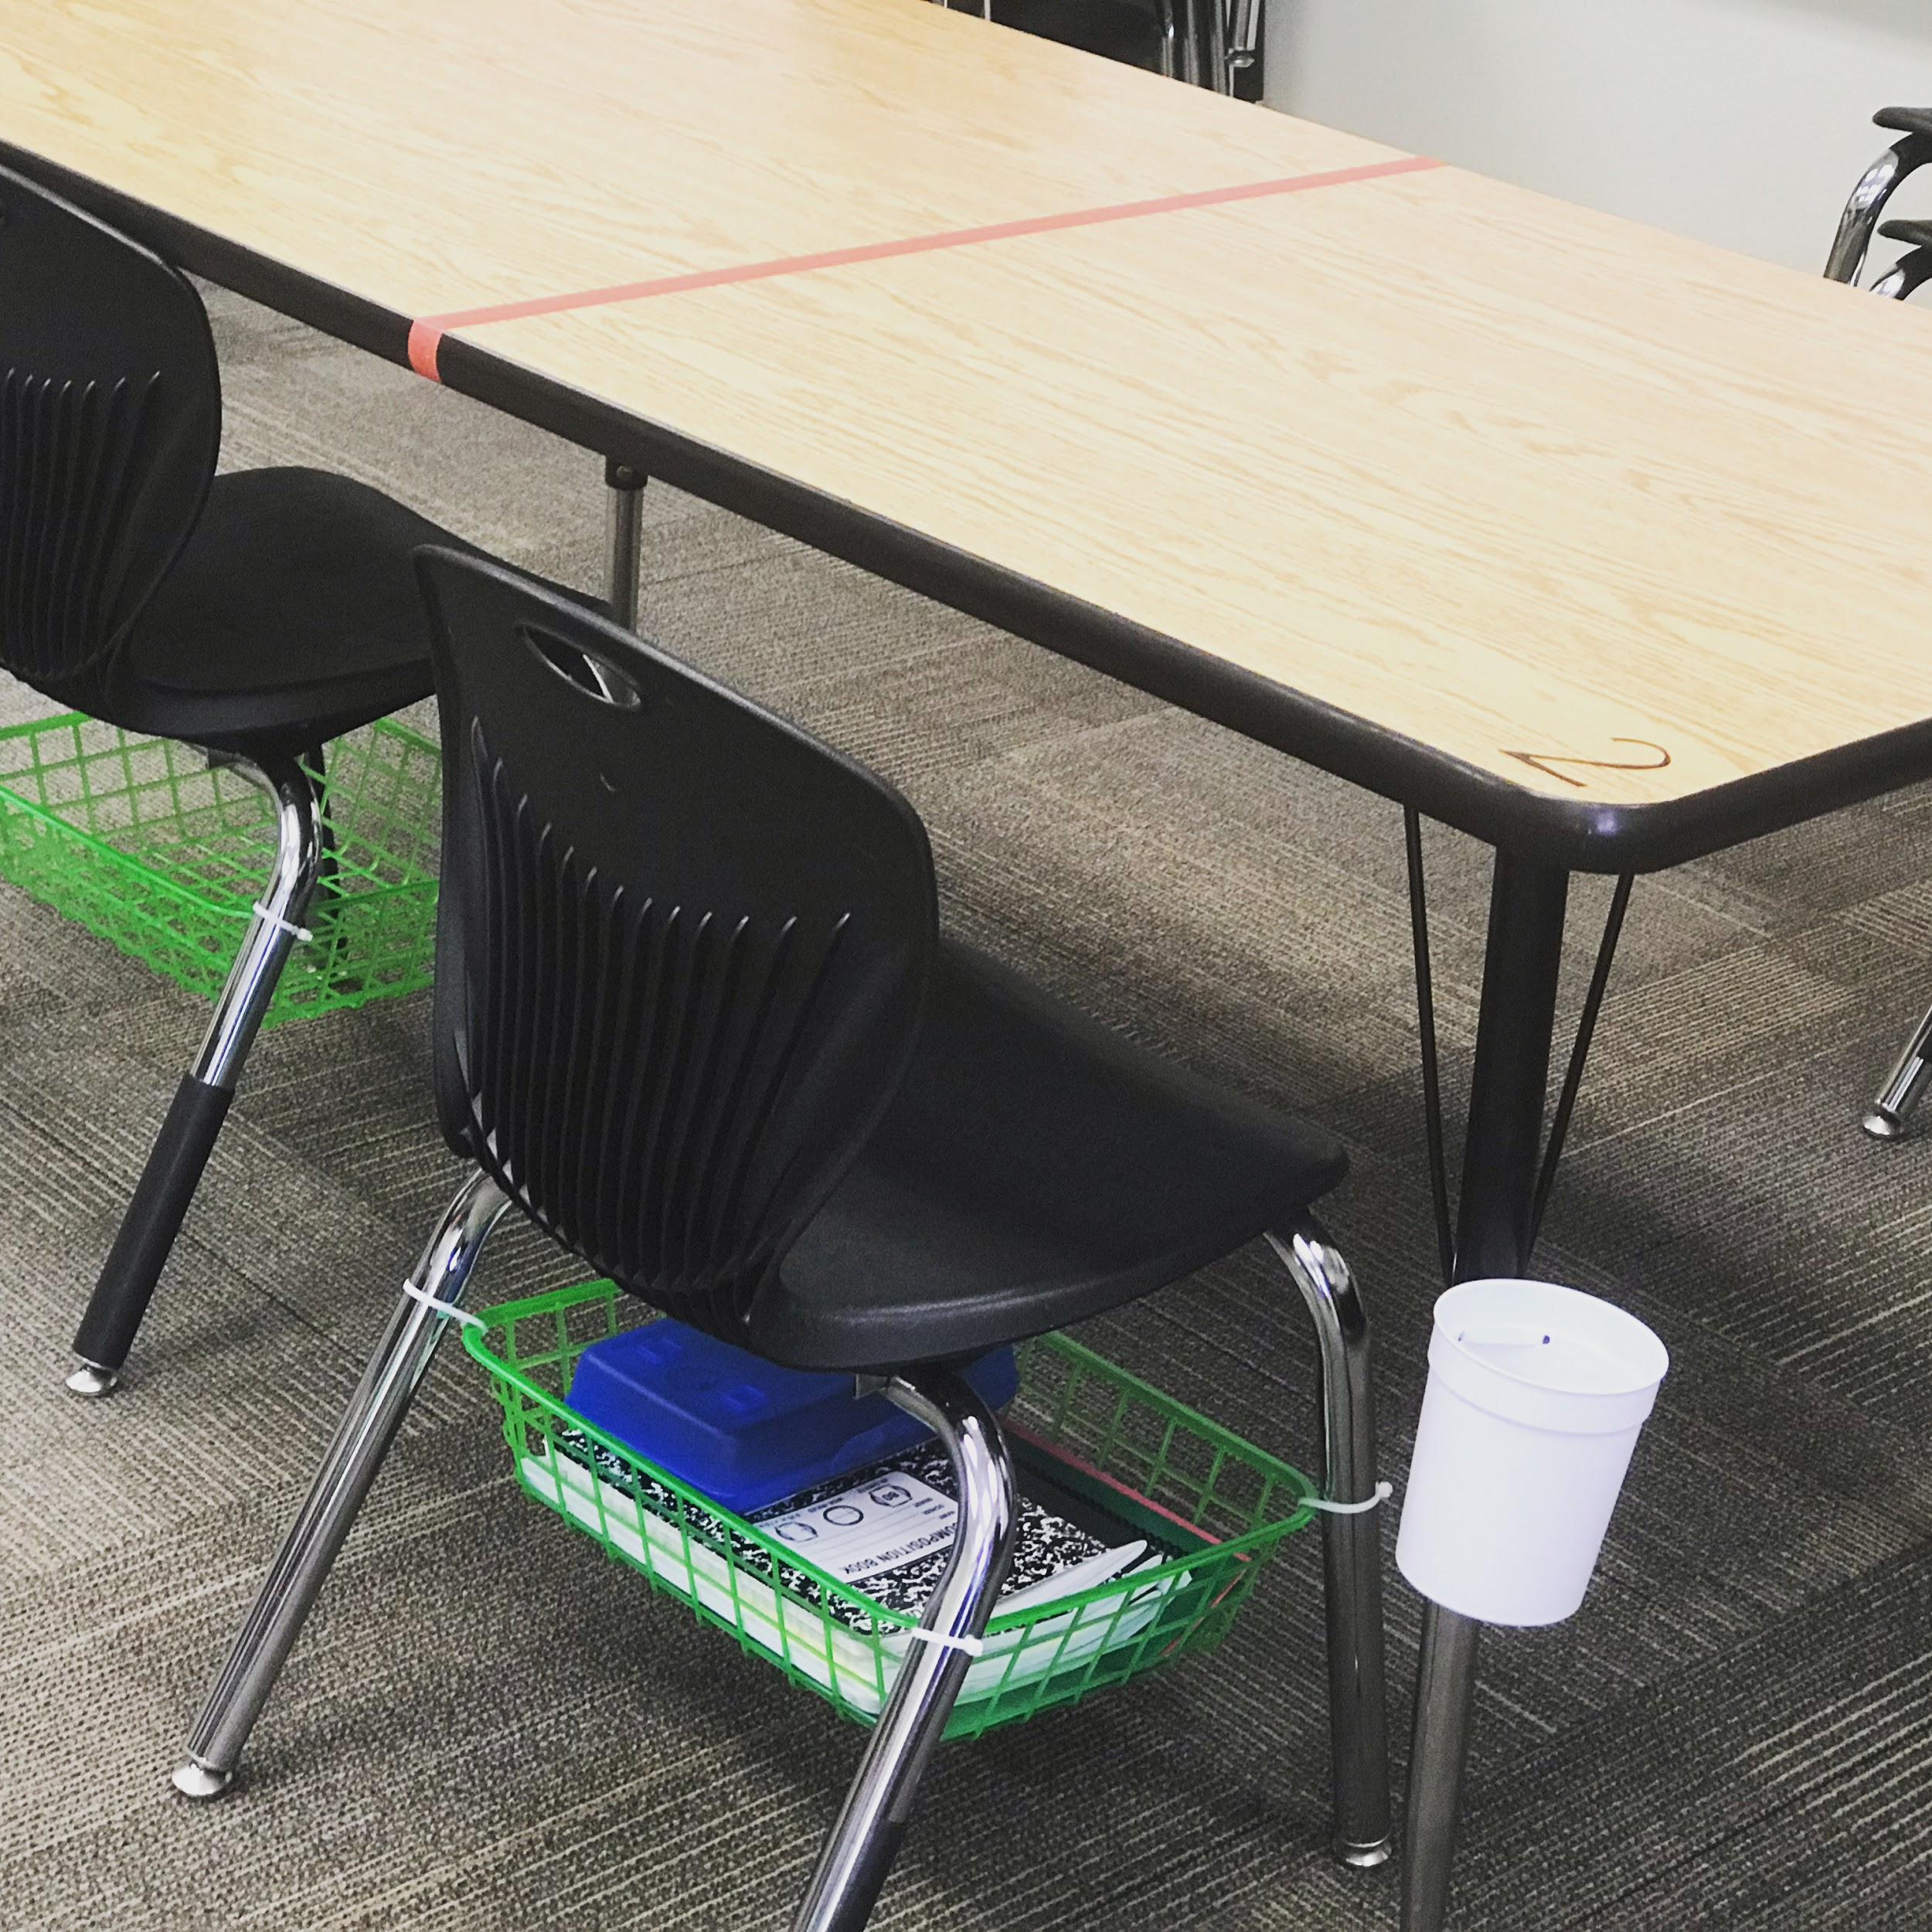
WELCOME To second grade
About Me
What to expect
classroom
Remote learning
FAQ
WEBSITE & EMAIL
Some students will be joining us in the classroom for face to face learning. Here is a picture of an example of how students will keep their supplies organized. Tables will be spaced to accommodate our safety guidelines. There will be 2 students per table, sitting at opposite ends.
We recommend having your child bring a water bottle with them to school. This will help us keep classroom water fountain use to a minimum. Please do not send any glass water bottles.
Remember, according to the student handbook, students are NOT allowed to bring backpacks or messenger bags to school.

Slide 8
WELCOME To Second GRADE
About Me
What to expect
classroom
Remote learning
FAQ
WEBSITE & EMAIL
We are excited to have our remote learners join us this year. Remote learners will be logging on to watch a live stream of lessons via Zoom. During the Zoom session you will see your teacher teaching from the classroom LIVE!
During the lesson, your microphone will be muted. If you have a question for the teacher about the
lesson during the live stream, you will hold up your
red question card in front of you. This will let the teacher know that you have a question. The teacher will be able to unmute you so you can ask your question. All students will be able to hear your question, as if you were in the classroom.
2rd Grade Remote Learning Schedule
(M, T, TH, F)
SFA Reading | 8:50am - 10:25am
Math | 10:25am - 11:25am
SPAM | 11:25am - 12:215pm
Lunch | 12:15pm - 12:45pm
World Lab | 12:50pm - 1:50pm
ELA | 1:50pm - 3:15pm

Slide 9
WELCOME To second GRADE
About Me
What to expect
classroom
Remote learning
FAQ
WEBSITE & EMAIL
What days will we go to recess?
You will go to recess on the days you don’t have PE. Your homeroom teacher can tell you what days of the week this will be.
Will students be able to eat a snack during the day?
Snack time will be at 10:30, students will eat as we begin our math lesson.
After we return from Reading class, students will have the chance to eat a small snack while they are checking their math homework. Snacks should be small and easy to eat. Examples of snack items that work well in the classroom are pretzels, crackers, grapes, or cheese sticks. Please try to avoid sending sugary snacks.

Slide 10
WELCOME To second GRADE
About Me
What to expect
classroom
Remote learning
FAQ
WEBSITE & EMAIL
Second Grade Website
http://cilsecondgrade.weebly.com/
Teacher Email Addresses
Mrs. Brubaker
Jacqueline.Brubaker@choicesinlearning.org
Mrs. Gekas
stephanie.gekas@choicesinlearning.org
Mr. Miller
derek.miller@choicesinlearning.org
Miss Jimenez
mckenzie.jimenez@choicesinlearning.org
Miss Smith
ceri.smith@choicesinlearning.org

